Slide 1

MUSTANG NEST LOCATOR
"Discover Your Ideal Abode with MustangNest Locator – Where Every Mustang Finds a Home Sweet Home."

Slide 2

“With time being a critical factor in the lives of students, the demand for tech-enabled and time-efficient apartment-hunting solutions has risen, reflecting the need for platforms that align with the fast-paced nature of academic schedules..”

Slide 3

HELLO!
Group 19

Slide 4




OUR TEAM
Dev Mukherjee
Jyoti Singh
Rahul Jogdankar
Roshan Dhaigude

Slide 5
TABLE OF CONTENTS
01
05
FACT CHECK
FEATURES
02
06
BUSINESS PROBLEM
ERD
03
SOLUTION & AUDIANCE
07
DEMO
04
08
KEY OBJECTIVE
FUTURE POENTIAL

Slide 6


FACT CHECK
TIME TO FIND A HOME
SIX WEEKS
20%
40%
Rent increase by 1/5th in last half decade
Renters reported facing unexpected fees
On average, it takes 4-8 weeks to find an apartment online in Dallas, Texas

Slide 7


BUSINESS PROBLEM
Inefficient, expensive, and opaque apartment search process hinders SMU students from accessing affordable, convenient housing near campus.

Slide 8





SOLUTION
MustangNest Locator offers an innovative solution, providing a streamlined, user-friendly platform that prioritizes simplicity, accessibility, and relevant information consolidation.
TARGET AUDIENCE
SMU STUDENTS
SMU PROF.
SMU STAFF

Slide 9
KEY OBJECTIVES
SIMPLE
INFOMRED
EFFICIENT
CHEAP
Streamlined interface for effortless discovery
Comprehensive insights for confident choices
Optimized for a seamless, enjoyable journey
Cost-effective options for affordability and financial ease

Slide 10







CRUD FEATURES
CREATE
READ
UPDATE
Inserts a new review into the database
Retrieve all reviews from database
Updates an existing review in the table
DELETE
Deletes a review from the table

Slide 11
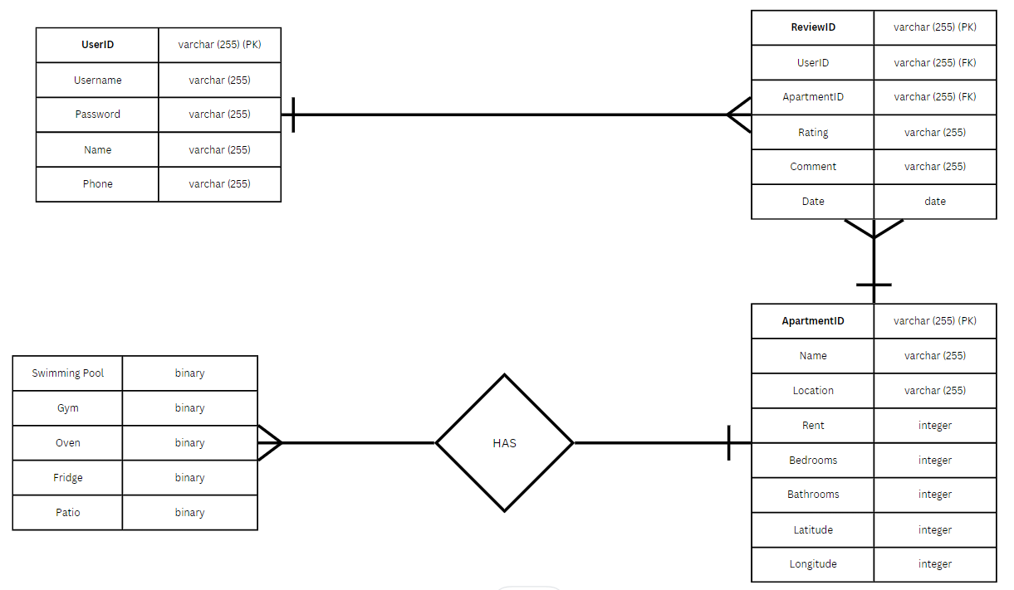
E-R DIAGRAM

Slide 12
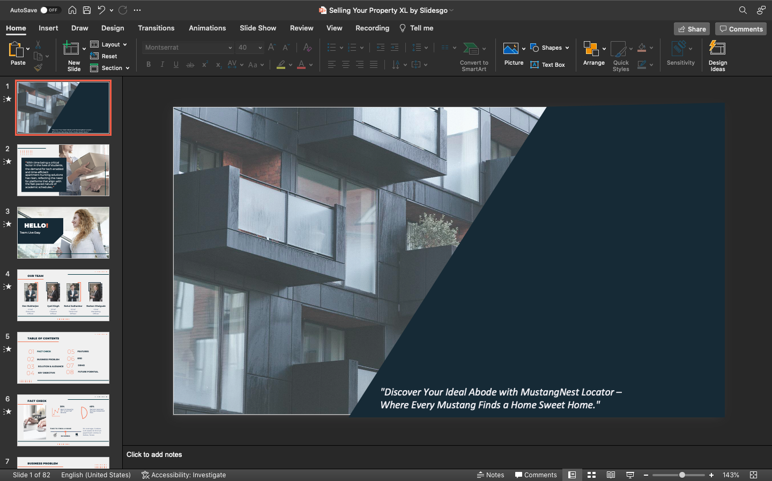
DEMO OF WEB INTERFACE
MUSTANG NEST LOCATOR
Sit Back, Relax and Enjoy your Show!

Slide 13

THANKS!
Open for Q & A

